Slide 1
Scrambled Speech Update
8-12-2024

Slide 2
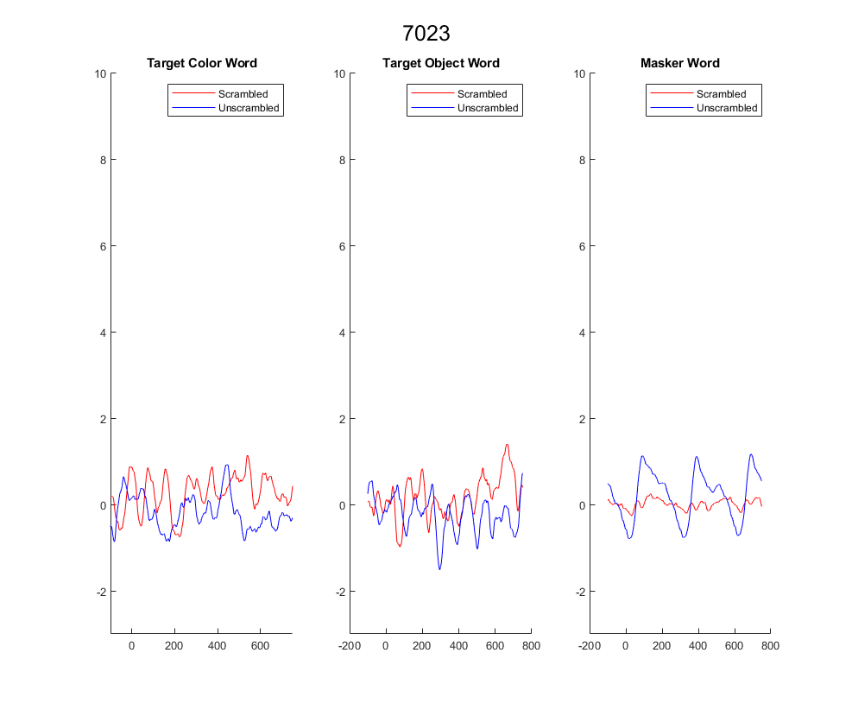
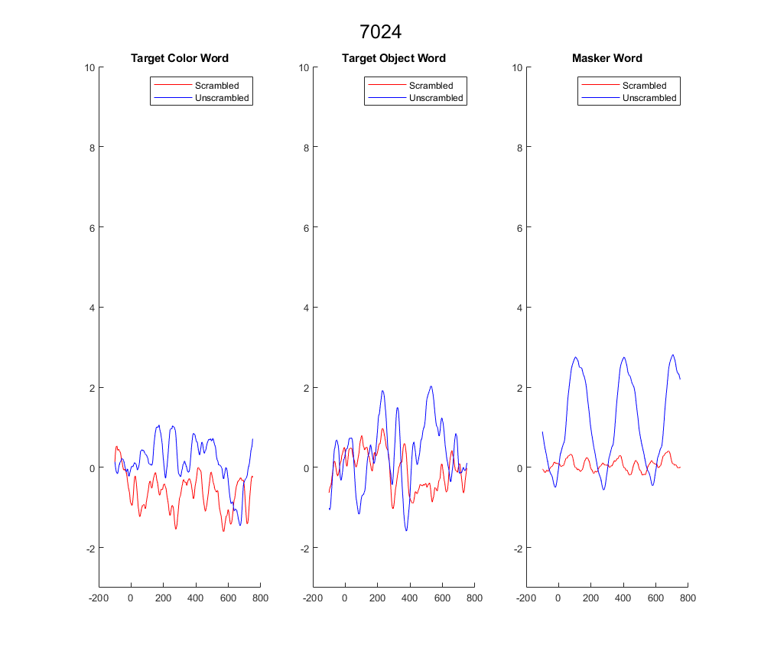
ERPs right now

Slide 3
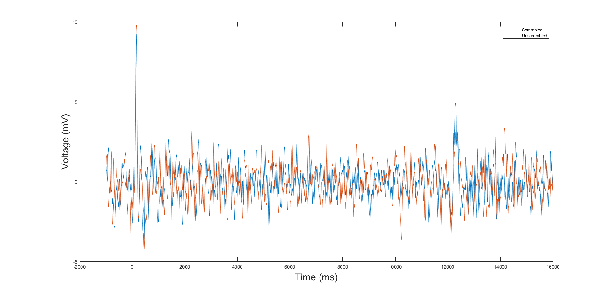
Response to whole trial

Slide 4
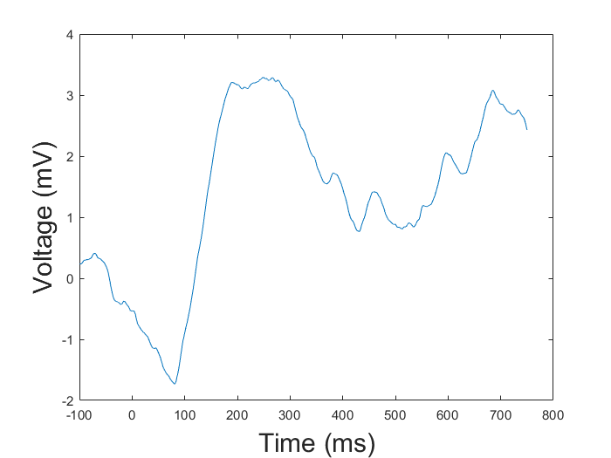
Plot button presses??

Slide 5
Break up by all four conditions

